Slide 1
PHP Form Validation
Course Code: CSC 3215
Course Title: WEB TECHNOLOGIES
Dept. of Computer Science
Faculty of Science and Technology
Lecturer No: | 3 | Week No: | 3 | Semester:
Lecturer: | Supta Richard Philip & richard@aiub.edu

Slide 2
Lecture Outline
Learning Objectives
PHP Form Handling
PHP Form Validation
Books and References

Slide 3
Learning Objectives
In this lecture , we will learn more details about HTML form elements i.e. different type of form, designing different type of HTML form.
We will also learn HTTP GET and POST.
Handling form data using $_GET or $_POST methods and validations form data using PHP.

Slide 4
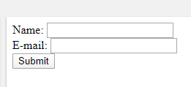
PHP Form Handling
The PHP superglobals $_GET and $_POST are used to collect form-data.
The example displays a simple HTML form with two input fields and a submit button using “get” and “post”
And See the difference.
<html> <body> <form action="welcome.php" method="post"> Name: <input type="text" name=“name"><br> E-mail: <input type="text" name="email"><br> <input type="submit"> </form> </body> </html>

Slide 5
PHP Form Handling
HTTP GET
The same result could also be achieved using the HTTP GET/POST method:
Welcome.php file
<html> <body> Welcome <?php echo $_POST[“name"]; ?><br> Your email address is: <?php echo $_POST["email"]; ?> </body> </html>

Slide 6
METHOD: GET vs. POST
 | GET | POST
BACK button/Reload | Harmless | Data will be re-submitted (the browser should alert the user that the data are about to be re-submitted)
Bookmarked | Can be bookmarked | Cannot be bookmarked
Cached | Can be cached | Not cached
Encoding type | application/x-www-form-urlencoded | application/x-www-form-urlencoded or multipart/form-data. Use multipart encoding for binary data

Slide 7
METHOD: GET vs. POST
History | Parameters remain in browser history | Parameters are not saved in browser history
Restrictions on data length | Yes, when sending data, the GET method adds the data to the URL; and the length of a URL is limited (maximum URL length is 2048 characters) | No restrictions
Restrictions on data type | Only ASCII characters allowed | No restrictions. Binary data is also allowed
Security | GET is less secure compared to POST because data sent is part of the URL Never use GET when sending passwords or other sensitive information! | POST is a little safer than GET because the parameters are not stored in browser history or in web server logs
Visibility | Data is visible to everyone in the URL | Data is not displayed in the URL

Slide 8
PHP Superglobals
Some predefined variables in PHP are "superglobals", which means that they are always accessible, regardless of scope - and you can access them from any function, class or file without having to do anything special.
The PHP superglobal variables are:
$GLOBALS
$_SERVER
$_REQUEST
$_POST
$_GET
$_FILES
$_ENV
$_COOKIE
$_SESSION

Slide 9
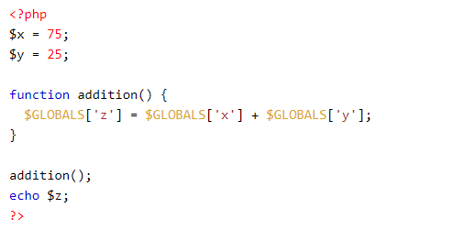
PHP $GLOBALS
$GLOBALS is a PHP super global variable which is used to access global variables from anywhere in the PHP script (also from within functions or methods).
PHP stores all global variables in an array called $GLOBALS[index]. The index holds the name of the variable.

Slide 10
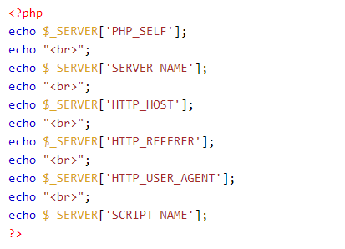
PHP $_SERVER
$_SERVER is a PHP super global variable which holds information about headers, paths, and script locations.

Slide 11
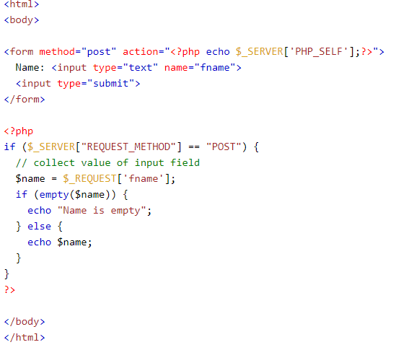
PHP $_REQUEST
PHP $_REQUEST is a PHP super global variable which is used to collect data after submitting an HTML form.

Slide 12
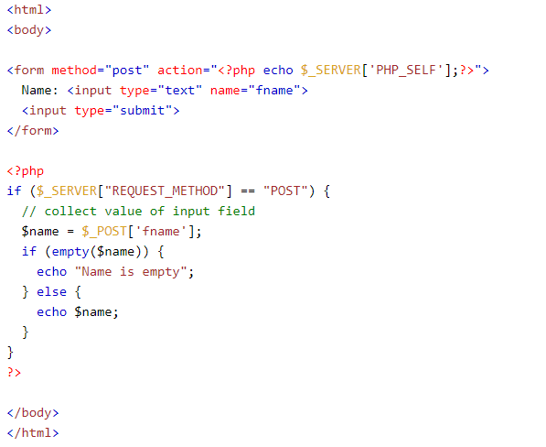
PHP $_POST
PHP $_POST is a PHP super global variable which is used to collect form data after submitting an HTML form with method="post". $_POST is also widely used to pass variables.

Slide 13
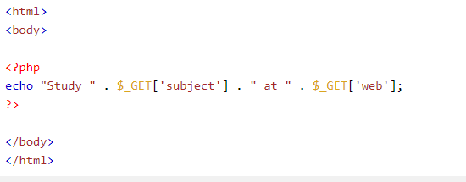
PHP $_GET
PHP $_GET is a PHP super global variable which is used to collect form data after submitting an HTML form with method="get".

Slide 14
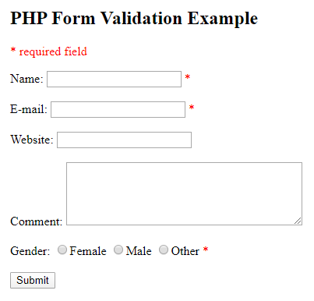
PHP Form Validation
Proper validation of form data is important to protect your form from hackers and spammers!
Lets consider the example.

Slide 15
PHP Form Validation
When your validation is passed, the hold the data in object.
Now write a class for student using name, email, etc. attributes(See the form).
Use this student object to hold the student data.

Slide 16
Books
W3Schools Online Web Tutorials; URL: http://www.w3schools.com
PHP Documentation; URL: http://www.php.net/docs.php
Sams Teach Yourself Ajax JavaScript and PHP All in One; Phil Ballard and Michael Moncur; Sams Publishing; 2010
JavaScript Phrasebook; Christian Wenz; Sams Publishing; 2007
PHP and MySQL Web Development, 4/E; Luke Welling and Laura Thomson; Addison-Wesley Professional; 2009
JavaScript for Programmers Paul J. Deitel and Harvey M. Deitel; Prentice Hall; 2009
Beginning PHP5, Apache, and MySQL Web Development; Elizabeth Naramore, Jason Gerner, Yann Le Scouarnec, Jeremy Stolz and Michael K. Glass; Wiley Publishing; 2005
XML in a Nutshell, 3/E; Elliotte Rusty Harold and W. Scott Means; O'Reilly Media; 2004

Slide 17
References
https://www.w3schools.com/php/php_forms.asp

